Slide 1
Unit -1 Operating System Overview

Slide 3
Operating System
A program that controls the execution of application programs
A program that controls the execution of users programs
An interface between applications and hardware

Slide 4
1. Operating System Objectives
Convenience
Makes the computer more convenient to use
Efficiency
Allows computer system resources to be used in an efficient manner
Ability to evolve
Permit effective development, testing, and introduction of new system functions without interfering with service

Slide 5
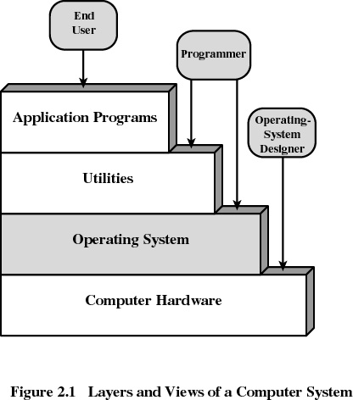
2. Layers of Computer System

Slide 6
Kernel
Heart (vital portion) of the operating system
Next to Hardware
It always resides in main memory
Contains most-frequently used functions
Also called the nucleus

Slide 7
3. Services Provided by the Operating System
Program development
Editors, compilers, linker, loader and debuggers
Program execution
Access to I/O devices
Controlled access to files
Access to other plug and play devices
Security to users programs and applications

Slide 8
Services Provided by the Operating System
Error detection and response
internal and external hardware errors
memory error
device failure
software errors
arithmetic overflow
access forbidden memory locations

Slide 9
Services Provided by the Operating System
Accounting
collect statistics
monitor performance

Slide 10
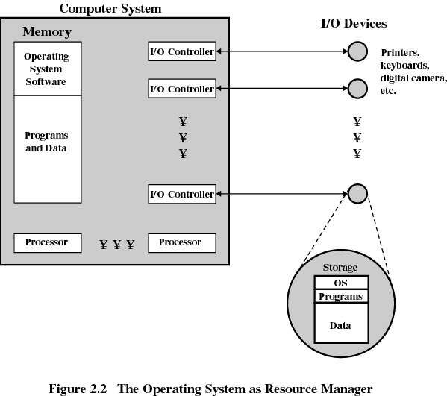

Slide 11
4. Evolution of Operating Systems
4.1 Serial Processing
No operating system
Machines run from a console with display lights and toggle switches, input device, and printer
Schedule tome
Setup included loading the compiler, source program, saving compiled program, and loading and linking

Slide 12
Evolution of Operating Systems
4.2 Simple Batch Systems
Monitors
Software that controls the running programs
Batch jobs together
Program branches back to monitor when finished
Resident monitor is in main memory and available for execution

Slide 13
Job Control Language (JCL)
Special type of programming language
Provides instruction to the monitor
what compiler to use
what data to use

Slide 14
Hardware Features
Memory protection
do not allow the memory area containing the monitor to be altered
Timer
prevents a job from monopolizing the system

Slide 15
Hardware Features
Memory protection
do not allow the memory area containing the monitor to be altered
Timer
prevents a job from monopolizing the system

Slide 16

4.3 Uniprogramming
Processor must wait for I/O instruction to complete before preceding

Slide 17
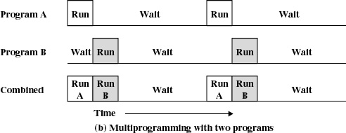
4.4 Multiprogramming
When one job needs to wait for I/O, the processor can switch to the other job

Slide 18
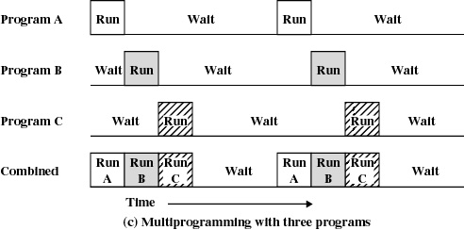
Multiprogramming

Slide 19
Example
JOB1 JOB2 JOB3
Type of job Heavy compute Heavy I/O Heavy I/O
Duration 5 min. 15 min. 10 min.
Memory required 50K 100 K 80 K
Need disk? No No Yes
Need terminal No Yes No
Need printer? No No Yes

Slide 20
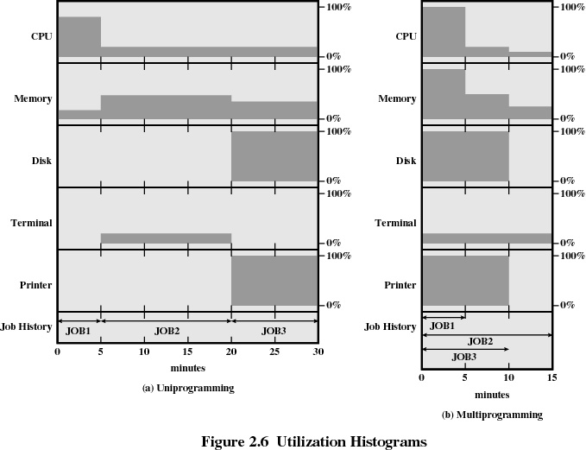

Slide 21
Effects of Multiprogramming
Uniprogramming Multiprogramming
Processor use 22% 43%
Memory use 30% 67%
Disk use 33% 67%
Printer use 33% 67%
Elapsed time 30 min. 15 min.
Throughput rate 6 jobs/hr 12 jobs/hr

Slide 22
4.5 Time Sharing
Using multiprogramming to handle multiple interactive jobs
Processor’s time is shared among multiple users
Multiple users simultaneously access the system through terminals

Slide 23
Batch Multiprogramming versus Time Sharing
 | Batch Multiprogramming | Time Sharing
Principal objective | Maximize processor use | Minimize response time
Source of directives to operating system | Job control language commands provided with the job | Commands entered at the terminal

Slide 24
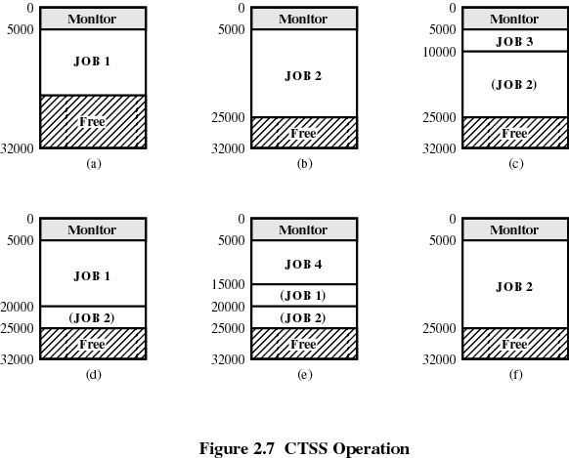
Compatible time sharing system (developed by MIT)

Slide 25
Major Achievements
Running processes simultaneously
Memory Management
Information protection and security
Scheduling and resource management

Slide 26
5. Processes
A program in execution
An instance of a program running on a computer
The entity that can be assigned to and executed on a processor
A unit of activity characterized by a single sequential thread of execution, a current state, and an associated set of system resources

Slide 27
Process
Consists of three components
An executable program
Associated data needed by the program
Execution context of the program
All information the operating system needs to manage the process

Slide 28
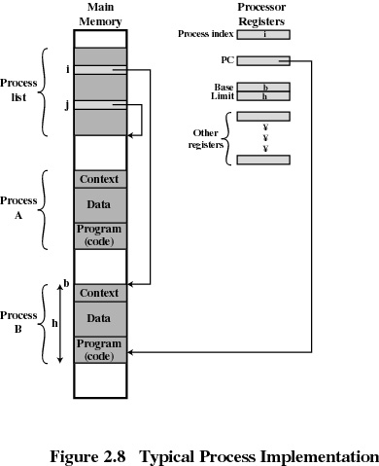
Process

Slide 29
6. Memory Management
Process isolation
Automatic allocation and management
Support for modular programming
Protection and access control
Long-term storage

Slide 30
Virtual Memory
Allows programmers to address memory from a logical point of view
While one process is written out to secondary store and the successor process read in there in no interruption

Slide 31
File System
Implements long-term store
Information stored in named objects called files

Slide 32
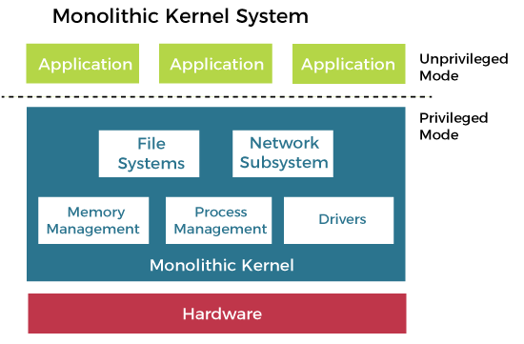
Monolithic Architecture

Slide 33
Advantages of Monolithic Architecture:
Simple and easy to implement structure.
Faster execution due to direct access to all the services
Disadvantages of Monolithic Architecture:
The addition of new features or removal of obsolete features is very difficult.
Security issues are always there because there is no isolation among various servers present in the kernel.

Slide 34
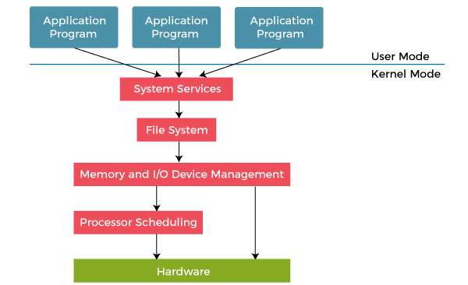
Kernel and User Space in Layered Architecture

Slide 35
Advantages of Layered Structure
Modularity: This design promotes modularity as each layer performs only the tasks it is scheduled to perform.
Easy debugging: As the layers are discrete so it is very easy to debug. Suppose an error occurs in the CPU scheduling layer. The developer can only search that particular layer to debug, unlike the Monolithic system where all the services are present.
Easy update: A modification made in a particular layer will not affect the other layers.
No direct access to hardware: The hardware layer is the innermost layer present in the design. So a user can use the services of hardware but cannot directly modify or access it, unlike the Simple system in which the user had direct access to the hardware.
Abstraction: Every layer is concerned with its functions. So the functions and implementations of the other layers are abstract to it.

Slide 36
Disadvantages of Layered Structure
Complex and careful implementation: As a layer can access the services of the layers below it, so the arrangement of the layers must be done carefully. For example, the backing storage layer uses the services of the memory management layer. So it must be kept below the memory management layer. Thus with great modularity comes complex implementation.
Slower in execution: If a layer wants to interact with another layer, it requests to travel through all the layers present between the two interacting layers. Thus it increases response time, unlike the Monolithic system, which is faster than this. Thus an increase in the number of layers may lead to a very inefficient design.
Functionality: It is not always possible to divide the functionalities. Many times, they are interrelated and can't be separated.
Communication: No direct communication between non-adjacent layers.

Slide 37
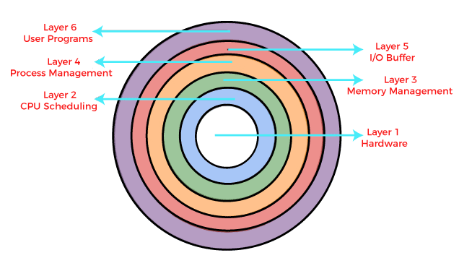
Layered Architecture

Slide 38
Information Protection and Security
Access control
regulate user access to the system
Information flow control
regulate flow of data within the system and its delivery to users
Certification
proving that access and flow control perform according to specifications

Slide 39
7. Scheduling and Resource Management
Fairness
give equal and fair access to all processes
Differential responsiveness
discriminate between different classes of jobs
Efficiency
maximize throughput, minimize response time, and accommodate as many uses as possible

Slide 40
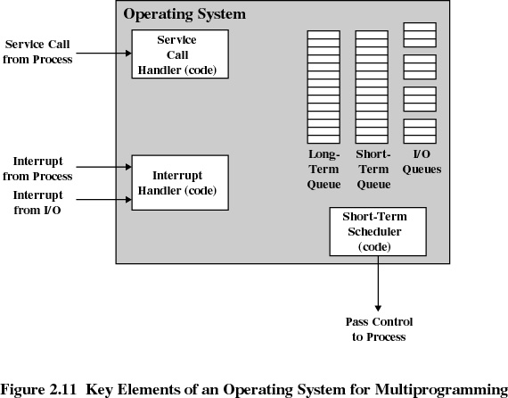
Major Elements of Operating System

Slide 41
System Structure
View the system as a series of levels
Each level performs a related subset of functions
Each level relies on the next lower level to perform more primitive functions
This decomposes a problem into a number of more manageable subproblems

Slide 42
8. Operating System Design Hierarchy
Level name Objects Example Operations
13. Shell User programming Statements in shell language environment
. User processes User processes Quit, kill, suspend, resume
11 . Directories Directories Create, destroy, attach, search, list
10. Devices External devices, such Open, close,
as printer, displays read, write
and keyboards
9. File system Files Create, destroy, open, close, read, write
8.Communications Pipes Create, destroy, open. close, read, write

Slide 43
Operating System Design Hierarchy
Level name Objects Example Operations
7.Virtual Memory Segments, pages Read, write, fetch
6. Local secondary Blocks of data, device Read, write, allocate, free store channels
5. Primitive processes primitive process, Suspend, resume, wait, signal,semaphores, ready list

Slide 44
Operating System Design Hierarchy
Level name Objects Example Operations
4 Interrupts Interrupt-handling Invoke, mask, unmask, Programs retry
Procedures Procedure, call stack, Mark stack, call, return
Instruction Set Evaluation stack, micro- Load, store, add, subtract program interpreter,
branch scalar and array data
Electronic Registers, gates, buses, Clear, transfer,
circuit activate, etc.

Slide 45
5. Characteristics of Modern Operating Systems
Microkernel architecture
assigns only a few essential functions to the kernel
address space
Inter-process communication (IPC)
basic scheduling

Slide 46
Characteristics of Modern Operating Systems
Multithreading
process is divided into threads that can run simultaneously
Thread
dispatchable unit of work
executes sequentially and is interruptible
Process is a collection of one or more threads

Slide 47
Characteristics of Modern Operating Systems
Multithreading
process is divided into threads that can run simultaneously
Thread
dispatchable unit of work
executes sequentially and is interruptible
Process is a collection of one or more threads

Slide 48
Characteristics of Modern Operating Systems
Distributed operating systems
provides the illusion of a single main memory and single secondary memory space
used for distributed file system

Slide 49
Characteristics of Modern Operating Systems
Object-oriented design
used for adding modular extensions to a small kernel
enables programmers to customize an operating system without disrupting system integrity

